Slide 1
React Redux

Slide 2
Redux
React-Redux
JavaScript Library for state management
Store
Reducer
Action
Constant
Provider
useSelector()
useDispatch()

Slide 3
State
Action
{
type: ‘WHAT_TO_DO’
payload: ‘DETAILS’
}
Reducer
Store
Provider

Slide 4
Key Concepts:
Redux Store: The single source of truth for the entire application state. All state changes are managed within this central store.
Actions: Plain JavaScript objects that describe what happened in the application (e.g., 'ADD_ITEM', 'UPDATE_USER'). They are the only way to trigger state changes. It may contain some additional information or payload.
Reducers: Pure functions that take the current state and an action as input, and return a new state. They specify how the application's state changes in response to actions.
Provider Component: A React Redux component that makes the Redux store available to all nested components within your React application.
useSelector Hook: A React Redux Hook that allows functional React components to extract data from the Redux store.
useDispatch Hook: A React Redux Hook that allows functional React components to dispatch actions to the Redux store, triggering state updates.

Slide 5
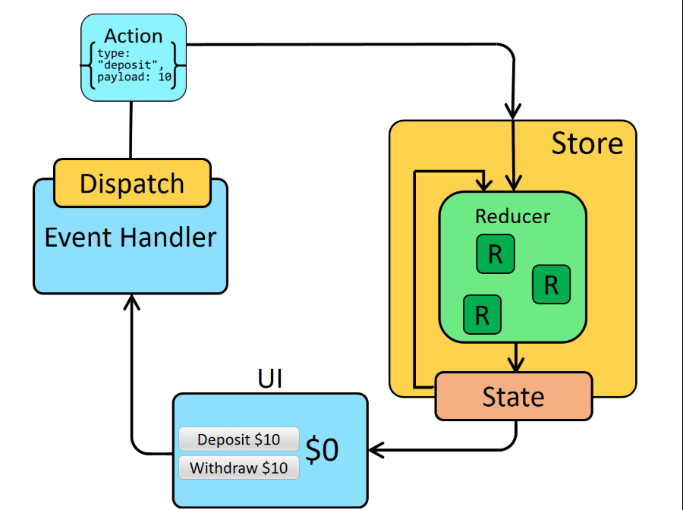
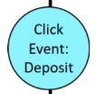


Slide 6
Thank You

